Slide 1
Introduction to Philosophy
Utilitarianism 1
Ethics or moral philosophy
is a branch of philosophy that investigates concepts of right and wrong conduct.
Meta-ethics
studies the meaning of moral language and the metaphysics of moral facts.
Normative ethics examines standards for the rightness and wrongness of actions.
Descriptive ethics
is an empirical investigation of people’s moral beliefs.

Slide 2
Introduction to Philosophy
Utilitarianism 1
Virtue ethics
focuses on the inherent character of a person rather than on specific actions.
Deontology
argues that decisions should be made considering the factors of one's duties and one's rights.
Consequentialism
argues that the morality of an action is contingent on the action's outcome or result.

Slide 3
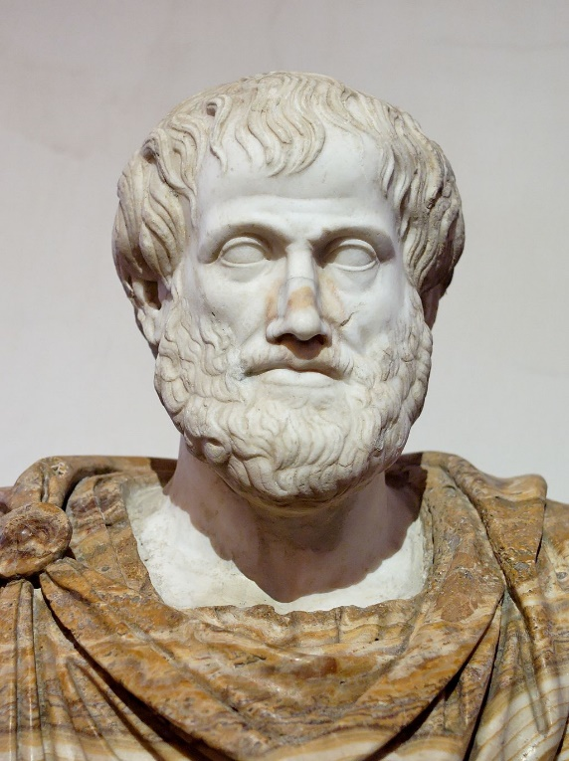
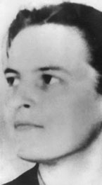
Introduction to Philosophy
Utilitarianism 1
Virtue ethics
focuses on the inherent character of a person rather than on specific actions.
St. Thomas Aquinas
G. E. M. Anscombe
Aristotle

Slide 4
Introduction to Philosophy
Utilitarianism 1
Moral Virtues
1. Courage in the face of fear
2. Temperance in the face of pleasure and pain
3. Liberality with wealth and possessions
4. Magnificence with great wealth and possessions
5. Magnanimity with great honors
6. Proper ambition with normal honors
7. Truthfulness with self-expression
8. Wittiness in conversation
9. Friendliness in social conduct
10. Modesty in the face of shame or shamelessness
11. Righteous indignation in the face of injury

Slide 5
Introduction to Philosophy
Utilitarianism 1
Some philosophers criticize virtue ethics as culturally relative. Since different people, cultures and societies often have different opinions on what constitutes a virtue, perhaps there is no one objectively right list.
Another objection to virtue theory is that it does not focus on what sorts of actions are morally permitted and which ones are not, but rather on what sort of qualities someone ought to foster in order to become a good person. This particular feature of the theory makes virtue ethics useless as a universal norm of acceptable conduct suitable as a base for legislation.

Slide 6
Introduction to Philosophy
Utilitarianism 1
Deontology
argues that decisions should be made considering the factors of one's duties and one's rights.
Immanuel Kant's
Categorical Imperative roots morality in humanity's rational capacity and asserts certain inviolable moral laws.
John Rawls’ contractualism
holds that the moral acts are those that we would all agree to if we were unbiased.
Natural rights theories, such that of John Locke or Robert Nozick, hold that human beings have absolute, natural rights.

Slide 7
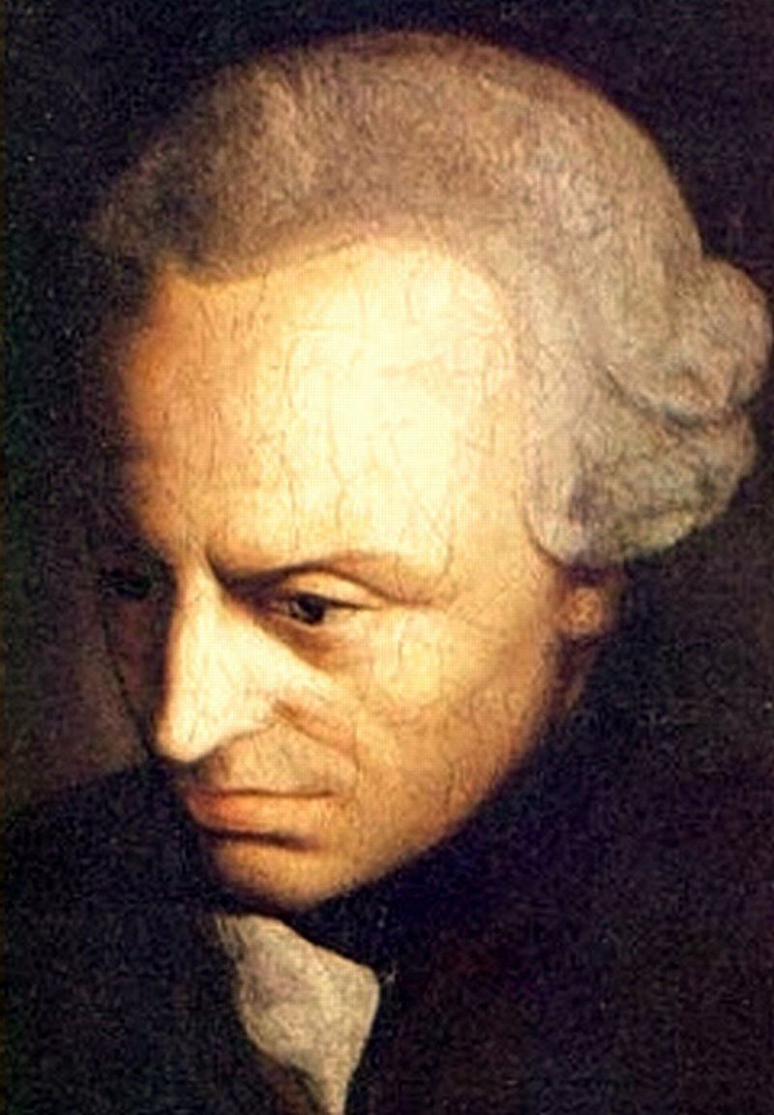
Introduction to Philosophy
Utilitarianism 1
Kant's categorical imperative:
Act only according to that maxim by which you can also will that it would become a universal law.

Slide 8
Introduction to Philosophy
Utilitarianism 1
Consequentialism
argues that the morality of an action is contingent on the action's outcome or result.
Welfarism
argues that the best action is the one that most increases economic well-being or welfare.
Egoism
is the belief that the moral person is the self-interested person, holds that an action is right if it maximizes good for the self.
Utilitarianism
holds that an action is right if it leads to the most happiness for the greatest number of people.

Slide 9
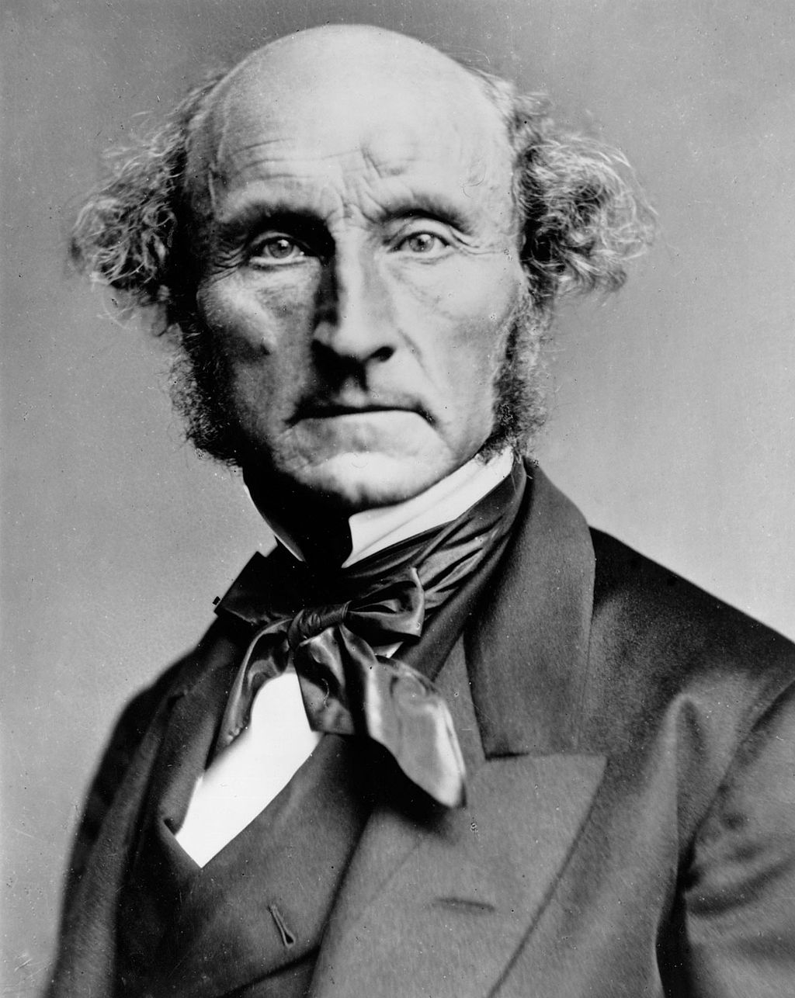
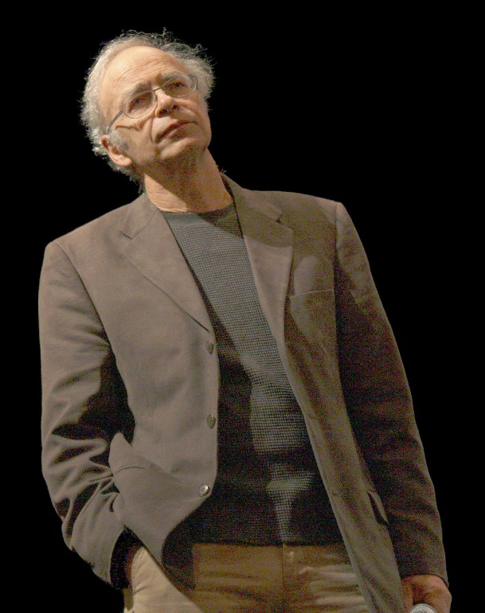
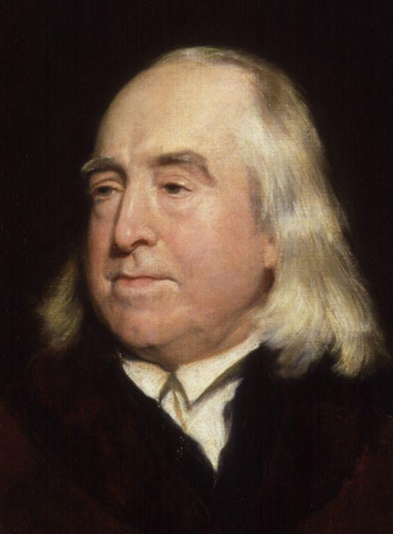
Introduction to Philosophy
Utilitarianism 1
Jeremy Bentham
John Stuart Mill
Peter Singer

Slide 10
Introduction to Philosophy
Utilitarianism 1
Some issues with utilitarianism
act utilitarianism vs. rule utilitarianism
total utilitarianism vs. average utilitarianism
What about animals?

Slide 11
Introduction to Philosophy
Utilitarianism 1
Some problems of utilitarianism
Ignores justice
Demandingness objection
Predicting consequences

Slide 12
Introduction to Philosophy
Utilitarianism 1
Do you think that an action is right if (and only if) it leads to the most happiness for the greatest number of people.
Why, or why not?

